Slide 1
Exam 70-534 Architecting Microsoft Azure Solutions
#1 Design Azure Resource Manager (ARM) networking (5–10%)
Design Azure virtual networks - Extend on-premises
Describe Azure VPN and Express Route architecture and design
#2 Secure resources (20–25%)
Secure resources by using managed identities
Secure resources by using managed identities
Secure resources by using identity providers
Identify an appropriate data security solution
Design a role-based access control (RBAC) strategy
Manage security risks by using an appropriate security solution
#3 Design an application storage and data access strategy (5–10%)
Design data storage
Select the appropriate storage option
#4 Design advanced applications (20–25%)
Create compute-intensive applications
Create long-running applications
Integrate Azure services in a solution
Implement messaging applications
Implement applications for background processing
Design connectivity for hybrid applications
#5 Design Azure Web and Mobile Apps (5–10%)
Design Web Applications
Design Mobile Applications
#6 Design a management, monitoring, and business continuity strategy (20–25%)
Design a monitoring strategy
Describe Azure business continuity/disaster recovery (BC/DR) capabilities
Design a disaster recovery strategy
Design Azure Automation and PowerShell workflows
Describe the use cases for Azure Automation configuration
#7 Architect an Azure Compute infrastructure (10–15%)
Design ARM Virtual Machines (VMs)
Design ARM template deployment
Design for availability
+ Bonus: Containers
https://www.microsoft.com/learning/en-us/exam-70-534.aspx

Slide 2

Design a Management, Monitoring and Business Continuity Strategy 70-534 Architecting MS Azure
Adnan Rafique MVP | MCSE Productivity | MCSA | MCT | MCITP
Masters in Technology Management Georgetown University Student 2018
@ExchangeITPro
adnan@techiesonly.com
Monitoring Strategy
BC/DR Capabilities
Design DR Strategy
Azure Automation and PS WF
Automation Use Cases

Slide 3
#6 Design a management, monitoring, and business continuity strategy (20–25%)
1. Design a monitoring strategy
Identify the Microsoft products and services for monitoring Azure solutions
leverage the capabilities of Azure Operations Management Suite and Azure Application Insights for monitoring Azure solutions
leverage built-in Azure capabilities
identify third-party monitoring tools, including open source
describe Azure architecture constructs, such as availability sets and update domains, and how they impact a patching strategy
analyze logs by using the Azure Operations Management Suite
4. Design Azure Automation and PowerShell workflows
Create a PowerShell script specific to Azure, automate tasks by using the Azure Operations Management Suite
2. Describe Azure business continuity/disaster recovery (BC/DR) capabilities
Leverage the architectural capabilities of BC/DR
describe Hyper-V Replica and Azure Site Recovery (ASR)
describe use cases for Hyper-V Replica and ASR
3. Design a disaster recovery strategy
Design and deploy Azure Backup and other Microsoft backup solutions for Azure
leverage use cases when StorSimple and System Center Data Protection Manager would be appropriate
design and deploy Azure Site recovery
5. Describe the use cases for Azure Automation configuration
Evaluate when to use Azure Automation, Chef, Puppet, PowerShell, or Desired State Configuration (DSC)

Slide 4
6.1 Monitoring Strategy
What Architects Need to Know

Slide 5
6.1 Design a monitoring strategy
Identify the Microsoft products and services for monitoring Azure solutions
leverage the capabilities of Azure Operations Management Suite and Azure Application Insights for monitoring Azure solutions
leverage built-in Azure capabilities
identify third-party monitoring tools, including open source
describe Azure architecture constructs, such as availability sets and update domains, and how they impact a patching strategy
analyze logs by using the Azure Operations Management Suite

Slide 6
6.1.1 Identify the Microsoft products and services for monitoring Azure Solutions
System Center
Configuration Manger – Client Device and Application Management
Operations Manager – Monitoring and Alerting
Virtual Machine Manager – DataCenter Mgt
Service Manager – ITIL based SM and Human WF + CMDB
Data Protection Manager – Backup and Disaster Recovery
Orchestrator – Workflow Engine
Azure Portal / Built-in Capabilities - Diagnostic Monitor
Global Service Monitor
Application Insights
Operations Management Suite

Slide 7
Design a Monitoring Strategy
Built-in Abilities
Diagnostic Monitor:
Web & Worker Roles
Global Service Manager
System Center Capabilities
Management Packs: Azure, Azure SQL, SQL
Third Party Tools
Open Source
Ops Manager, Application Insights (VSO) – Telemetry Data
Use Cases for WSUS
Config Manager
Custom Solutions
Architecture Constructs: Availability Groups and Update Domains

Slide 8
Designing Management and Monitoring for Azure
Notes:
This highlights how the data for monitoring and diagnostics can come from a variety of data sources.
The instrumentation and collection stages are concerned with identifying the sources from where the data needs to be captured,
determining which data to capture,
how to capture it,
and how to format this data so that it can be easily examined.
The analysis/diagnosis stage takes the raw data and uses it to generate meaningful information that an operator can use to determine the state of the system. The operator can use this information to make decisions about possible actions to take, and then feed the results back into the instrumentation and collection stages.
The visualization/alerting stage phase presents a consumable view of the system state. It can display information in near real time by using a series of dashboards. And it can generate reports, graphs, and charts to provide a historical view of the data that can help identify long-term trends.
If information indicates that a KPI is likely to exceed acceptable bounds, this stage can also trigger an alert to an operator. In some cases, an alert can also be used to trigger an automated process that attempts to take corrective actions, such as autoscaling.
https://docs.microsoft.com/en-us/azure/architecture/best-practices/monitoring#the-monitoring-and-diagnostics-pipeline

Slide 9
Global Services Monitor
Used to monitor web applications in internal and external locations
Create synthetic transactions used to simulate remote user traffic from a specific global location
Notes:
System Center Global Service Monitor is a cloud service that provides a simplified way to monitor the availability of external-web-based applications from multiple locations around the world.
Importantly, Global Service Monitor monitors applications from the perspective of the customers who use them.
Because Global Service Monitor monitors from locations that are correlated to customer geographies, application owners can gain insight into customer experiences in addition to the separate problems related to external factors, such as Internet or network problems, from application or service problems.
The Global Service Monitor monitoring experience focuses on the application instead of the infrastructure or individual URL.
The Operations Manager console integration lets you monitor web applications from both internal and external locations
GSM lets you monitor web applications from 16 locations and then report back to your management group.
A maximum number of tests for the two monitoring types
These are the Web Application Availability monitoring that monitors single URLs, and Visual Studio Web Tests monitoring
https://technet.microsoft.com/en-us/library/jj860368.aspx

Slide 10
Application Insights
Detect and diagnose issues in Web apps and services
Alerts through email or webhooks
Diagnose exceptions and performance issues
Perform root cause analysis and initiate azure automation runbook
Live application monitoring
HTTP metrics, Dependency (SQL) response times, Log tracing, View and Session counts, Server performance, Availability tests
Notes:
Application Insights is an extensible Application Performance Management (APM) service for web developers on multiple platforms.
Use it to monitor your live web application. It will automatically detect performance anomalies.
It includes powerful analytics tools to help you diagnose issues and to understand what users actually do with your app.
It's designed to help you continuously improve performance and usability. It works for apps on a wide variety of platforms including .NET, Node.js and J2EE, hosted on-premises or in the cloud. It integrates with your devOps process, and has connection points to a variety of development tools.
Request rates, response times, and failure rates
Performance counters from your Windows or Linux server machines, such as CPU, memory, and network usage.
Page views and load performance - reported by your users' browsers.
Dependency rates, response times, and failure rates - Find out whether external services are slowing you down.
https://docs.microsoft.com/en-us/azure/application-insights/app-insights-overview

Slide 11
Application Map (Insights)
Notes:
The map shows:
Availability tests
Client-side component (monitored with the JavaScript SDK)
Server-side component
Dependencies of the client and server components
You can expand and collapse dependency link groups:
https://docs.microsoft.com/en-us/azure/application-insights/app-insights-app-map

Slide 12
Application Map (Insights)
Notes:
The map shows:
If you use SQL Azure, there's an icon that shows when there are recommendations on how you can improve performance.
https://docs.microsoft.com/en-us/azure/application-insights/app-insights-app-map

Slide 13
Operations Management Suite
OMS has the following functionality:
Log Analysis
Connect VMs to OMS using portal, powershell, CLI, or ARM Templates
Can read from Azure storage and diagnostic logs
Automation
Azure automation runbooks
Disaster Recovery
Azure Backup and Site Recovery
Security and Compliance
Analyzes security events
Notes:
Operations Management Suite (also known as OMS) is a collection of management services that were designed in the cloud from the start.
Rather than deploying and managing on-premise resources, OMS components are entirely hosted in Azure.
Configuration is minimal, and you can be up and running literally in a matter of minutes.+
Minimal cost and complexity of deployment. Because all of the components and data for OMS are stored in Azure, you can be up and running in a short time without the complexity and investment in on-premise components.
Scale to cloud levels. You don’t have to worry about paying for compute resources that you don’t need or about running out of storage space since the cloud allows you to pay only for what you actually use and will readily scale to any load you require. You can start by managing a few resources to get started and then scale up to your entire environment.
Take advantage of the latest features. Features in OMS services are continuously being added and updated. You constantly have access to the latest features without any requirement to deploy updates. [Talk about Big Data here and it can improve the monitoring]
Integrated services. While each of the OMS services provide significant value on their own, they can work together to solve complex management scenarios. For example, a runbook in Azure Automation might drive a failover process with Azure Site Recovery and then log information to Log Analytics to generate an alert.
Global knowledge. Management solutions in OMS continuously have access to the latest information. The Security and Audit solution for example, can perform a threat analysis using the latest threats being detected around the world.
Access from anywhere. Access your management environment from anywhere you have a browser. Install the OMS app on your smartphone for ready access to your monitoring data.
https://docs.microsoft.com/en-us/azure/operations-management-suite/operations-management-suite-overview

Slide 14
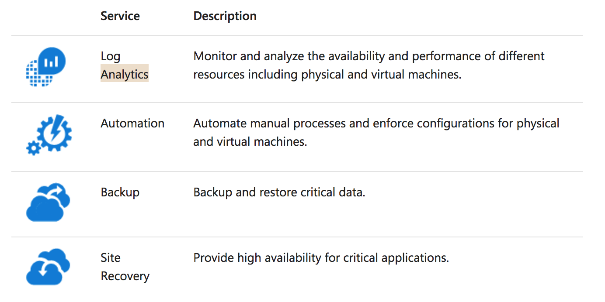
OMS Services
Notes:
The core functionality of OMS is provided by a set of services that run in Azure.
Each service provides a specific management function, and you can combine services to achieve different management scenarios
https://docs.microsoft.com/en-us/azure/operations-management-suite/operations-management-suite-overview

Slide 15
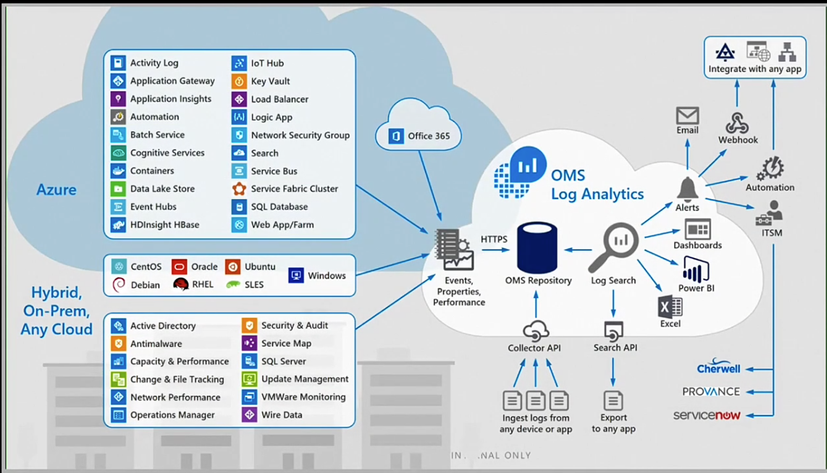
OMS Services
Notes:
The core functionality of OMS is provided by a set of services that run in Azure.
Each service provides a specific management function, and you can combine services to achieve different management scenarios
https://docs.microsoft.com/en-us/azure/operations-management-suite/operations-management-suite-overview

Slide 16
OMS Services – Log Analytics
Notes:
Log Analytics provides monitoring services for OMS by collecting data from managed resources into a central repository.
This data could include events, performance data, or custom data provided through the API.
Once collected, the data is available for alerting, analysis, and export.
This method allows you to consolidate data from a variety of sources so you can combine data from your Azure services with your existing on-premises environment.
It also clearly separates the collection of the data from the action taken on that data so that all actions are available to all kinds of data
Windows and Linux
You install the Microsoft Monitoring Agent on Windows and Linux computers or virtual machines that you want to collect data from.
Azure services. Log Analytics collects telemetry from Azure Diagnostics and Azure Monitoring into the repository so that you can monitor Azure resources.
Data Collector API. Log Analytics has a REST API for populating data from any client.
Solution Packs
AD Replication Health Solution Packs, AD Replication Solution Pack, Over network health. Tons of 3rd party tool
Views and dashboards – output
Power BI- you can export to Power BI
Log Search API. – to export to 3rd part tool
https://docs.microsoft.com/en-us/azure/operations-management-suite/operations-management-suite-overview

Slide 17
OMS Services – Log Analytics Vmware Monitoring
Notes:
Log Analytics provides monitoring services for OMS by collecting data from managed resources into a central repository.
This data could include events, performance data, or custom data provided through the API.
Once collected, the data is available for alerting, analysis, and export.
This method allows you to consolidate data from a variety of sources so you can combine data from your Azure services with your existing on-premises environment.
It also clearly separates the collection of the data from the action taken on that data so that all actions are available to all kinds of data
Windows and Linux
You install the Microsoft Monitoring Agent on Windows and Linux computers or virtual machines that you want to collect data from.
Azure services. Log Analytics collects telemetry from Azure Diagnostics and Azure Monitoring into the repository so that you can monitor Azure resources.
Data Collector API. Log Analytics has a REST API for populating data from any client.
Solution Packs
AD Replication Health Solution Packs, AD Replication Solution Pack, Over network health. Tons of 3rd party tool
Views and dashboards – output
Power BI- you can export to Power BI
Log Search API. – to export to 3rd part tool
https://docs.microsoft.com/en-us/azure/operations-management-suite/operations-management-suite-overview

Slide 18
OMS Services – Log Analytics
SQL Analytics
DNS Analytics
WebApp Analytics
Capacity and Performance
Notes:
https://docs.microsoft.com/en-us/azure/log-analytics/log-analytics-azure-sql

Slide 19
OMS Services – Log Analytics
SQL Analytics
DNS Analytics
WebApp Analytics
AD Assessment
AD Replication Status
Change Tracking
Notes:
https://docs.microsoft.com/en-us/azure/log-analytics/log-analytics-azure-sql

Slide 20
OMS Services – Process Automation
Notes:
Hybrid
Resources in your data center most likely cannot be accessed from a runbook running in the cloud.
You can install one or more Hybrid Runbook Workers (HRW) in your data center
When runbooks run in the cloud, they can access any resources accessible from the cloud.
This could be resources in your Azure subscription, in another cloud such as Amazon Web Services (AWS), or a service accessible through a REST API.
https://docs.microsoft.com/en-us/azure/operations-management-suite/operations-management-suite-overview

Slide 21
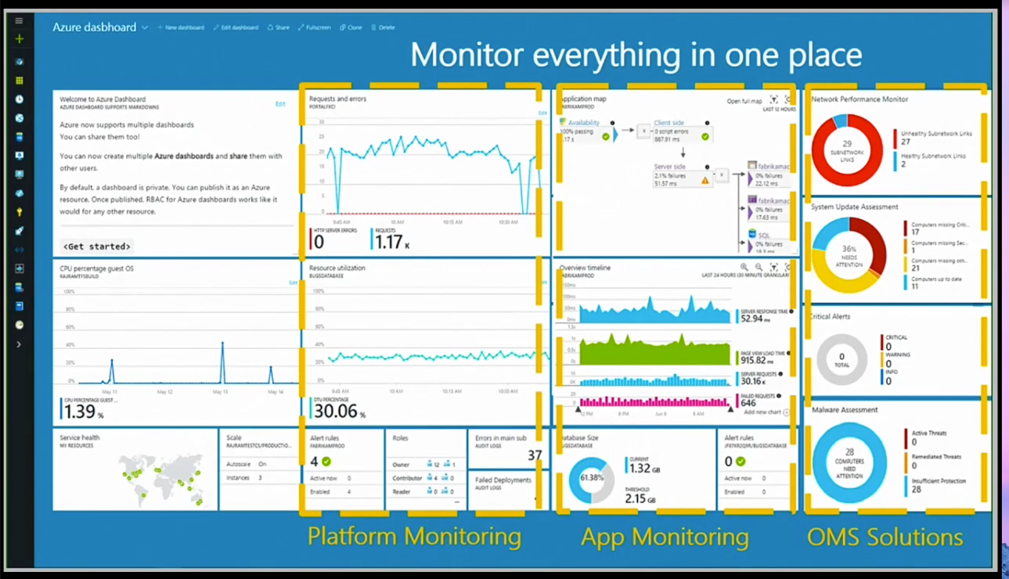
OMS Services – Security And Compliance
Notes:
Hybrid
Resources in your data center most likely cannot be accessed from a runbook running in the cloud.
You can install one or more Hybrid Runbook Workers (HRW) in your data center
When runbooks run in the cloud, they can access any resources accessible from the cloud.
This could be resources in your Azure subscription, in another cloud such as Amazon Web Services (AWS), or a service accessible through a REST API.
https://docs.microsoft.com/en-us/azure/operations-management-suite/operations-management-suite-overview

Slide 22
OMS Services – Security And Compliance
The OMS Security and Audit dashboard is organized in four major categories:
Security Domains
Notable Issues
Detection (Preview)
Threat Intelligence
Common security queries
Notes:
Hybrid
Resources in your data center most likely cannot be accessed from a runbook running in the cloud.
You can install one or more Hybrid Runbook Workers (HRW) in your data center
When runbooks run in the cloud, they can access any resources accessible from the cloud.
This could be resources in your Azure subscription, in another cloud such as Amazon Web Services (AWS), or a service accessible through a REST API.
https://docs.microsoft.com/en-us/azure/operations-management-suite/operations-management-suite-overview

Slide 23
OMS Services – Security And Compliance Data Collection
collects and processes data
Security event log
Event Tracing for Windows (ETW) events
AppLocker auditing events
Windows Firewall log
Advanced Threat Analytics events
Results of baseline assessment
Results of antimalware assessment
Results of update/patch assessment
Syslogs streams that are explicitly enabled on the agent
Notes:
Hybrid
Resources in your data center most likely cannot be accessed from a runbook running in the cloud.
You can install one or more Hybrid Runbook Workers (HRW) in your data center
When runbooks run in the cloud, they can access any resources accessible from the cloud.
This could be resources in your Azure subscription, in another cloud such as Amazon Web Services (AWS), or a service accessible through a REST API.
https://docs.microsoft.com/en-us/azure/operations-management-suite/operations-management-suite-overview

Slide 24
OMS Services – Security And Audit Threat Intelligence
Notes:
https://docs.microsoft.com/en-us/azure/operations-management-suite/oms-security-responding-alerts

Slide 25
System Center for Azure Overview
Deploy on-premises typically or Azure VMs
On-premises can monitor Azure VMs
Site-to-Site VPN/Express Route
Gateway Server
Domain Joined Machines or Certificate based Auth for non-domain
Notes:
Operations Manager, a component of Microsoft System Center 2016, is software that helps you monitor services, devices, and operations for many computers from a single console.
This topic explains basic concepts about Operations Manager for the administrator who manages the Operations Manager infrastructure and the operator who monitors and supports the IT services for your business.
https://docs.microsoft.com/en-us/system-center/scom/key-concepts

Slide 26
Operations Manager for Azure
Use Azure Management Pack to monitor Azure Subscriptions
Availability and performance of resources in Azure
Automatically discovers and starts collection of performance/monitoring data in Azure for cloud services, storage, VMs, Azure SQL, and Web Apps
Hybrid allows for monitoring of both on-premises and Azure.
Pay for bandwidth out of Azure
Notes:
For hybrid solutions review: https://docs.microsoft.com/en-us/system-center/scom/deploy-install-gateway-server
Gateway servers are used to enable agent-management of computers that are outside the Kerberos trust boundary of management groups, such as in a domain that is not trusted.
The gateway server acts as a concentration point for agent-to-management server communication. Agents in domains that are not trusted communicate with the gateway server and the gateway server communicates with one or more management servers. Because communication between the gateway server and the management servers occurs over only one port (TCP 5723), that port is the only one that has to be opened on any intervening firewalls to enable management of multiple agent-managed computers. Multiple gateway servers can be placed in a single domain so that the agents can failover from one to the other if they lose communication with one of the gateway servers.
Similarly, a single gateway server can be configured to failover between management servers so that no single point of failure exists in the communication chain.

Slide 27
Operations Manager
Recommend on-premises deployment due to VM and system requirements in Azure.
Uses Azure Management Pack to manage subscription
Can use agent or agentless monitoring
Agentless monitoring provides less functionality
Use Site-to-Site VPN or express route
Notes:
See the Management Pack Guide. Download here: https://www.microsoft.com/en-us/download/details.aspx?id=50013
The Management Pack for Microsoft Azure enables you to monitor the availability and performance of Azure resources that are running on Microsoft Azure.
The management pack runs on a specified server pool, and then uses Microsoft Azure REST APIs to remotely discover and collect performance information about the specified Microsoft Azure resources.
This management pack focuses on the collection of performance metrics made available by Azure Services that use Azure Resource Manager.
Azure Active Directory is used for authenticating Azure REST API calls.
This management pack queries Azure REST APIs to enumerate the resources running in an Azure subscription and the performance metrics available for each resource.
Virtual machines, web roles, and worker roles can store events and performance counters into Azure table storage by means of Azure diagnostics. If these resources are configured to use Azure diagnostics, this Management Pack can collect these events and performance counters.

Slide 28
Azure Monitoring Strategies
Azure Monitor
Application Insights
Log Analytics
Notes:
There is a range of tools for monitoring Azure applications and services. Some of their features overlap. This is partly for historical reasons and partly due to the blurring between development and operation of an application.
Here are the principal tools:
Azure Monitor is basic tool for monitoring services running on Azure. It gives you infrastructure-level data about the throughput of a service and the surrounding environment. If you are managing your apps all in Azure, deciding whether to scale up or down resources, then Azure Monitor gives you what you use to start.
Application Insights can be used for development and as a production monitoring solution. It works by installing a package into your app, and so gives you a more internal view of what’s going on. Its data includes response times of dependencies, exception traces, debugging snapshots, execution profiles. It provides powerful smart tools for analyzing all this telemetry both to help you debug an app and to help you understand what users are doing with it. You can tell whether a spike in response times is due to something in an app, or some external resourcing issue. If you use Visual Studio and the app is at fault, you can be taken right to the problem line(s) of code so you can fix it.
Log Analytics is for those who need to tune performance and plan maintenance on applications running in production. It is based in Azure. It collects and aggregates data from many sources, though with a delay of 10 to 15 minutes. It provides a holistic IT management solution for Azure, on-premises, and third-party cloud-based infrastructure (such as Amazon Web Services). It provides richer tools to analyze data across more sources, allows complex queries across all logs, and can proactively alert on specified conditions. You can even collect custom data into its central repository so can query and visualize it.
System Center Operations Manager (SCOM) is for managing and monitoring large cloud installations. You might be already familiar with it as a management tool for on-premises Windows Sever and Hyper-V based-clouds, but it can also integrate with and manage Azure apps. Among other things, it can install Application Insights on existing live apps. If an app goes down, it tells you in seconds. Note that Log Analytics does not replace SCOM. It works well in conjunction with it.
https://docs.microsoft.com/en-us/azure/monitoring-and-diagnostics/monitoring-overview

Slide 29
Azure Monitoring
Use the Azure Portal to monitor Web Apps, VMs by default.
Good Short term solution for point-in-time view
Monitoring writes data to Azure Storage
Can use Visual Studio to view
Configure Alerts from the portal based on performance metrics
Know the SLAs
Notes:
Azure Monitor provides base level infrastructure metrics and logs for most services in Microsoft Azure. Azure services that do not yet put their data into Azure Monitor will in the future.+
Microsoft ships additional products and services that provide additional monitoring capabilities for developers, DevOps, or IT Ops that also have on-premises installations. For an overview and understanding of how these different products and services work together
https://docs.microsoft.com/en-us/azure/monitoring-and-diagnostics/monitoring-overview-azure-monitor
The Service Level Agreement (SLA) describes Microsoft’s commitments for uptime and connectivity.
https://azure.microsoft.com/en-us/support/legal/sla/summary/

Slide 30
VM Monitoring
Must have the VM Agent installed
Basic, Network, .NET, Windows Event Logs, IIS Logs, Diagnostic Logs
Notes:
The Microsoft Azure Virtual Machine Agent (VM Agent) is a secured, lightweight process that manages VM interaction with the Azure Fabric Controller. The VM Agent has a primary role in enabling and executing Azure virtual machine extensions. VM Extensions enabling post deployment configuration of virtual machines, such as installing and configuring software. Virtual machine extensions also enable recovery features such as resetting the administrative password of a virtual machine. Without the Azure VM Agent, virtual machine extensions cannot be run.
https://docs.microsoft.com/en-us/azure/virtual-machines/virtual-machines-windows-agent-user-guide

Slide 31
Cumulative Updates
VMs are up-to-date at time of deployment
Admins are responsible for IaaS VM updates
Using built in update service can lead to unexpected downtime
Cumulative Update Strategy
Monthly Roll-up – All previous combined
Security-only – pervious month only
.Net Framework monthly roll-up – pervious month only
Notes:
Security-only update Definition: An update that collects all the new security updates for a given month and for a given product, addressing security-related vulnerabilities and distributed through Windows Server Update Services (WSUS), System Center Configuration Manager and Microsoft Update Catalog.
Security vulnerabilities are rated by their severity. The severity rating is indicated in the Microsoft security bulletin as critical, important, moderate, or low. This Security-only update would be displayed under the title Security Only Quality Update when you download or install the update and will be classified as an "Important" update.
Monthly Rollup Definition: A tested, cumulative set of updates. They include both security and reliability updates that are packaged together and distributed over Windows Update, WSUS, System Center Configuration Manager and Microsoft Update Catalog for easy deployment. The Monthly Rollup is product specific, addresses both new security issues and nonsecurity issues in a single update and will proactively include updates that were released in the past. Security vulnerabilities are rated by their severity. The severity rating is indicated in the Microsoft security bulletin as critical, important, moderate, or low. This Monthly Rollup would be displayed under the title Security Monthly Quality Rollup when you download or install. This Monthly Rollup will be classified as an "Important" update on Windows Update and will automatically download and install if your Windows Update settings are configured to automatically download and install Important updates.
https://support.microsoft.com/en-us/help/824684/description-of-the-standard-terminology-that-is-used-to-describe-microsoft-software-updates

Slide 32
WSUS and IaaS
Supports updates for all Microsoft products
Allows you to approve updates
Separate IaaS VMs into different groups to manage different patch levels
Provides a basic level of reporting
Clients responsible for reporting back
WSUS deployed to azure can manage Azure VMs and on-premises clients
WSUS for approvals only – Data changes for egress
Notes:
Simple WSUS deployment
The most basic WSUS deployment consists of a server inside the corporate firewall that serves client computers on a private intranet. The WSUS server connects to Microsoft Update to download updates. This is known as synchronization.
During synchronization, WSUS determines if any new updates have been made available since the last time you synchronized. If it is your first time synchronizing WSUS, all updates are made available for download.
Multiple WSUS servers
Administrators can deploy multiple servers running WSUS that synchronize all content within their organization's intranet.
You might expose only one server to the Internet, which would be the only server that downloads updates from Microsoft Update.
This server is set up as the upstream server the source to which the downstream servers synchronize. When applicable, servers can be located throughout a geographically dispersed network to provide the best connectivity to all client computers.
https://docs.microsoft.com/en-us/windows-server/administration/windows-server-update-services/plan/plan-your-wsus-deployment#a-namebkmk12a12-choose-a-wsus-deployment-scenario

Slide 33
Configuration Manager and IaaS
Support for Microsoft and 3rd party updates
Intended for client OS
Requires WSUS to be installed
Deploys as packages not updates
ConfigMan client must be installed on VMs
Provides in-depth reporting/Compliance reporting
Notes:
After installing the WSUS server role on your server, you need to properly configure it.
The following checklist summarises the steps involved in performing the initial configuration for your WSUS server.
TaskDescription2.1. Configure network connectionsConfigure the cluster network by using the Network Configuration Wizard
.2.2. Configure WSUS by using the WSUS Configuration WizardUse the WSUS Configuration wizard to perform the base WSUS configuration.
2.3. Configure WSUS computer groupsCreate computer groups in the WSUS administration console to manage updates in your organization
.2.4. Configure client updatesSpecify how and when automatic updates are applied to client computers.
2.5. Secure WSUS with the Secure Sockets Layer ProtocolConfigure Secure Sockets Layer (SSL) protocol to help protect Windows Server Update Services (WSUS).
https://docs.microsoft.com/en-us/windows-server/administration/windows-server-update-services/deploy/2-configure-wsus

Slide 34
Updating Linux
OSPatching Extension for Linux
Allows for automated patching of Linux Operating systems
Requires Linux Agent
Configured using Azure-CLI or PowerShell module
https://github.com/Azure/azure-linux-extensions/tree/master/OSPatching
Notes:
Allow the owner of the Azure VM to configure the Linux VM patching schedule cycle. And the actual patching operation is automated based on the pre-configured schedule.
https://github.com/Azure/azure-linux-extensions/tree/master/OSPatching

Slide 35
Availability Sets
Availability sets provide redundancy to your application.
Must contain the same OS and VM size
Used to configure Fault/Update domains
If using managed disks, must use a managed availability set
Notes:
In Azure, virtual machines (VMs) can be placed in to a logical grouping called an availability set.
When you create VMs within an availability set, the Azure platform distributes the placement of those VMs across the underlying infrastructure.
Should there be a planned maintenance event to the Azure platform or an underlying hardware / infrastructure fault, the use of availability sets ensures that at least one VM remains running.
https://docs.microsoft.com/en-us/azure/virtual-machines/windows/infrastructure-availability-sets-guidelines

Slide 36
Fault Domains & Update Domains
Fault domains define the group of virtual machines that share a common power source and network switch.
Update domains indicate groups of virtual machines and underlying physical hardware that can be rebooted at the same time.
Notes:
Each virtual machine in your availability set is assigned an update domain and a fault domain by the underlying Azure platform.
For a given availability set, five non-user-configurable update domains are assigned by default (Resource Manager deployments can then be increased to provide up to 20 update domains) to indicate groups of virtual machines and underlying physical hardware that can be rebooted at the same time.
When more than five virtual machines are configured within a single availability set, the sixth virtual machine is placed into the same update domain as the first virtual machine, the seventh in the same update domain as the second virtual machine, and so on.
The order of update domains being rebooted may not proceed sequentially during planned maintenance, but only one update domain is rebooted at a time.
https://docs.microsoft.com/en-us/azure/virtual-machines/windows/manage-availability#configure-multiple-virtual-machines-in-an-availability-set-for-redundancy

Slide 37
6.2 Azure (BC/DR) capabilities
What Architects Need to Know

Slide 38
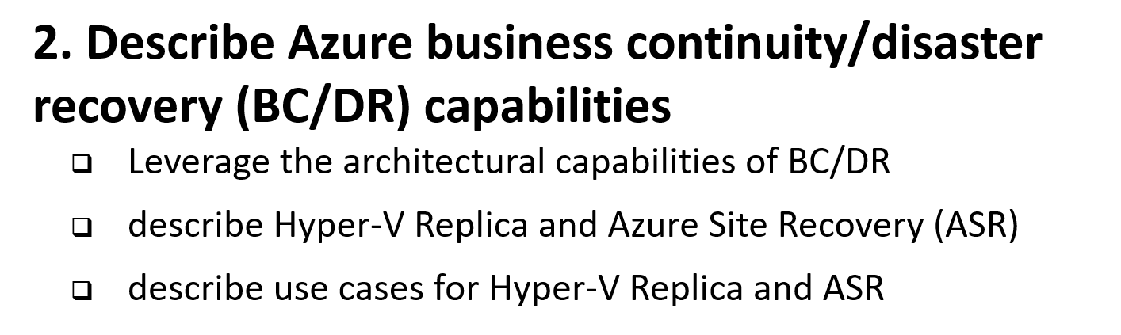
6 Manage, Monitory, Business Continuity

Slide 39
Azure PowerShell Module
Azure ARM vs Azure Classic
Install
Web Platform Installer
Azure Gallery (install-module)
Notes:
Here you can give the example how to import the template from the gallery. A template for backup and it will look all the machine in your environment and make recommendation for the backup. If backup is part of the compliance policy you can force that as well. One time install and configure and automates everything. You can import the runbooks here bascially

Slide 40
PS Workflows for Azure
Workflows are used for long running tasks
Support for checkpoints
Can suspend and resume
Can retry on failure
Tasks can be performed in a specific sequence
This helps insure correct order of tasks
Next task cannot start until pervious is completed

Slide 41
Configuration Automation
Custom Script extensions
Allows to run a script after VM deployment
Make deployments of configuration reliable and repeatable
Perform tasks across a large number of machines
Infrastructure through code

Slide 42
Azure Automation
Visual and Text based Runbooks
Contains code and assets like connections strings and auth tokens
Automate configuration and deployment of all azure resources
Runbooks are based on PowerShell or PowerShell workflows
Runbooks can call other runbooks
Runbook Gallery

Slide 43
Architectural capabilities of BC/DR
You need all three
Primary site
Primary site
Secondary site
Original
Backup
DATA
DATA
High availability
Disaster recovery
Backup
When your applications have a catastrophic failure, run a second instance
When your applications have a catastrophic failure, run them in Azure or a secondary datacenter
When your data is corrupted, deleted or lost you can restore it
Notes:
Now let’s make sure we are using the same terminology for the various parts of a business continuity strategy.
HA is
DR is
Backup is
I’m going to focus on Backup and DR.

Slide 44
RPO “Recover Point Objective” & RTO “Recover Time Objective are time intervals, typically expressed in number of hours
RPO is the maximum targeted time that data can be lost (in time)—it is the amount of time between backup, replication, or synchronization. It answers the question, “What is an acceptable amount of data loss?” It is usually much smaller than RTO.
RTO is how long it takes (in time) to restore services after a disaster. It answers the question, “How long will it take to get service back up?”
Notes:
Read word by word.
It 80% of the exam

Slide 45
Architectural capabilities of BC/DR
Recovery Point Objective (RPO) and Recovery Time Objective (RTO)
Drivers of solution cost
Minimal data loss
Reduce downtime
Availability: Storage redundancy & SLAs
Blob storage: (LRS, GRS, RA-GRS), SLAs
Synchronous vs asynchronous (how data is written)
SQL Server Always On Availability Groups (replication for availability)
Network connectivity
Application connectivity post failover
IP management
Load balancers
Notes:
RPO is the amount of data that can be lost (in time)—it is the amount of time between backup, replication, or synchronization. It answers the question, “What is an acceptable amount of data loss?” It is usually much smaller than RTO.
RTO is how long it takes to restore services after a disaster. It answers the question, “How long will it take to get service back up?”

Slide 46
An asynchronous operation is one that transpires sequentially: first one action, and then another. The operations do not take place simultaneously. This type of processing means that there is a time gap between the first operation and the second. An example would be writing data to primary and secondary storage. First data is written to the primary; data destined for the secondary is queued and must wait until the write operation to the primary is complete.
Notes:
Just read AS IS
Think of this as sequential processing

Slide 47
Synchronous means that operations are carried out at the same time (think of this as parallel processing). With this type of processing, there is no time gap between the first process and the second process. Both operations take place simultaneously.
Notes:
Just read AS IS
Think of it as a Parallel Processing

Slide 48
What is Business Continuity and Disaster Recovery (BC/DR)
Business Continuity (BC)
Disaster Recovery (DR)
Planning and preparation to ensure that the business can continue to operate (in a reasonable amount of time) after a disaster or serious business disruptive event.
Preventing or minimizing impact of a disaster or service disruptor event
Key Elements:
Resiliency – Keep running in case of failure
Recover – Recover or restore business functions that fail
Contingency - Plans in place in case an event happens. and is not covered by Resiliency or Recovery.
Business Continuity often deals with more than just technology. (eg. Plan for critical person/people that leave the company). This element not likely on the exam, but it does matter when you architect solutions in real life. If you have read “The Phoenix Project” it would be Brent!
Creating policies and processes to quickly restore services, data, and systems to full functionality
Recovering from a Disaster after it happens. It is often linked to Business Continuity as it is a subset of the Business Continuity plan.
Key Elements:
Availability, High Availability
Urgency to getting systems up and to what % of service.
Cost vs Time vs Risk
Hot/Worm/Cold site
Recovery as a Service (RaaS)
Disaster Recovery as a Service (DRaaS)
Cost to businesses for not doing BC/DR can be catastrophic

Slide 49
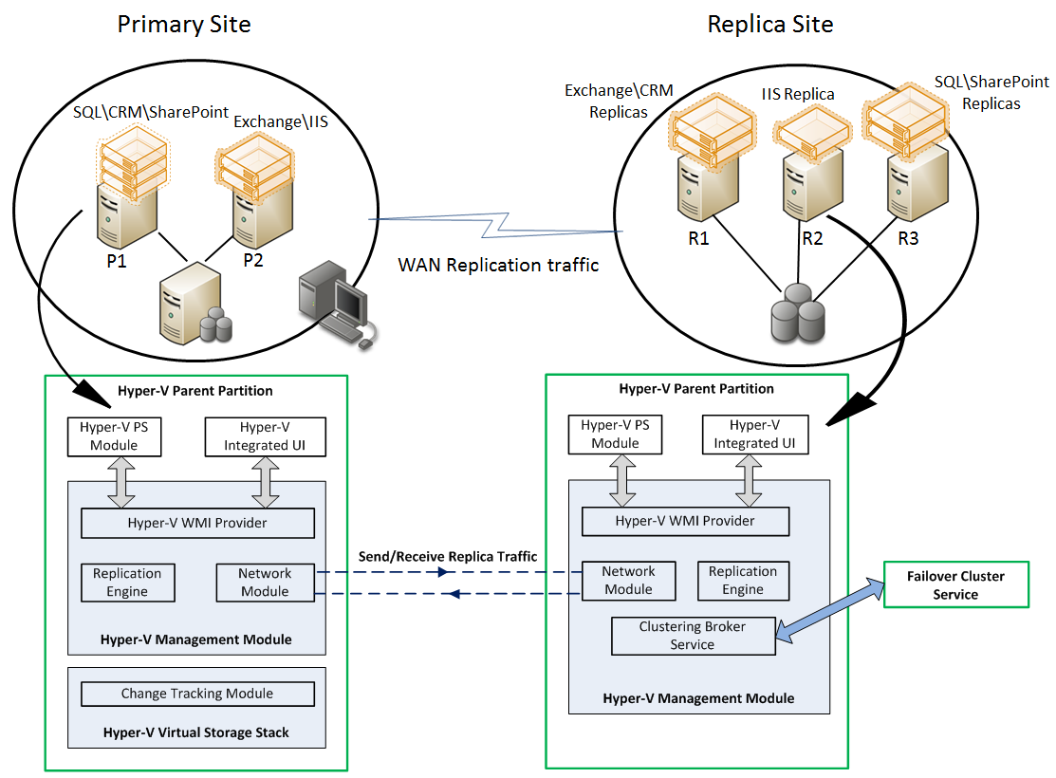
Hyper-V Replica
Asynchronous replication of VM changes (enable on primary and replica site)
Replication is on a per VM basis over HTTP
Supports planned failovers, test failovers, unplanned failovers
No shared storage or external replication technologies required
WHEN NOT
Workload requires synchronous replication, data outside of VHD
Workload needs to recover physical servers, beyond Hyper-V replica’s capabilities

Slide 50
Hyper-V Replica
Hyper-V role in Windows Server 2012 or greater
Sufficient storage at the Primary and Replica sites to host virtual workloads
Network connectivity between the Primary and Replica sites
Properly configured firewall rules to permit replication
X.509v3 certificate(s) to support Mutual Authentication with certificates (not required)
Notes:
Now let’s make sure we are using the same terminology for the various parts of a business continuity strategy.
HA is
DR is
Backup is
I’m going to focus on Backup and DR.

Slide 51
Hyper-V Replica & ASR use cases
Primarily for disaster recovery and business continuity
Site to site cross-replication protection (ASR to Azure offering failover)
Host failure within a site (Hyper-V replica)
Migration mechanism to move from one site to another
Notes:
Now let’s make sure we are using the same terminology for the various parts of a business continuity strategy.
HA is
DR is
Backup is
I’m going to focus on Backup and DR.

Slide 52
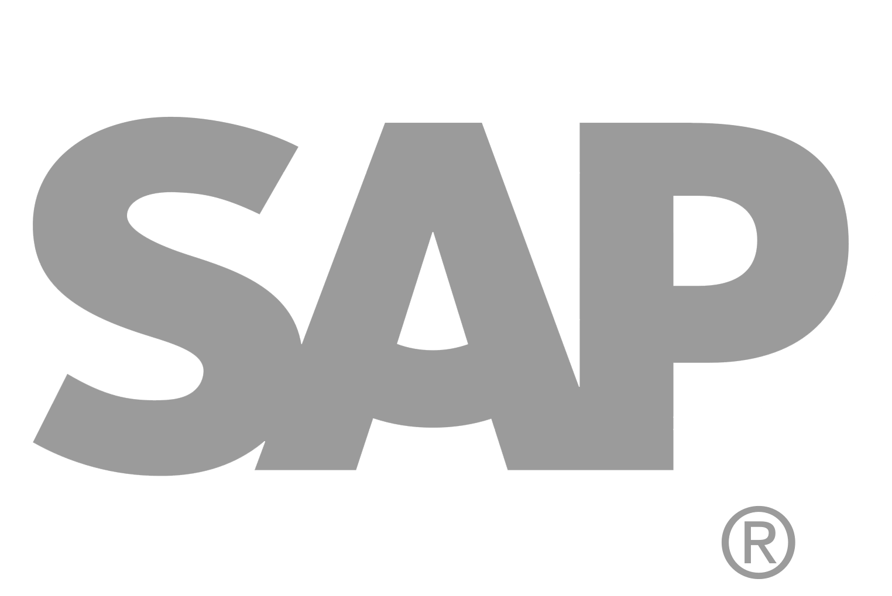
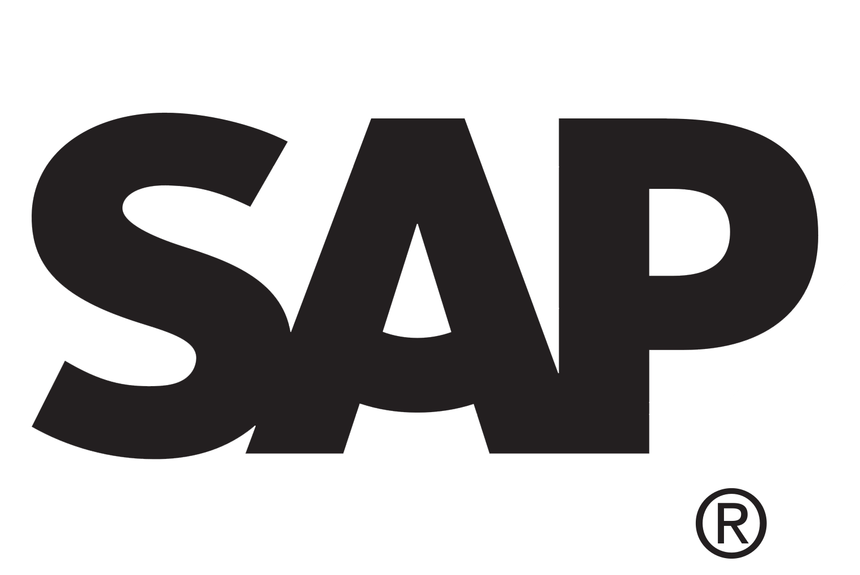
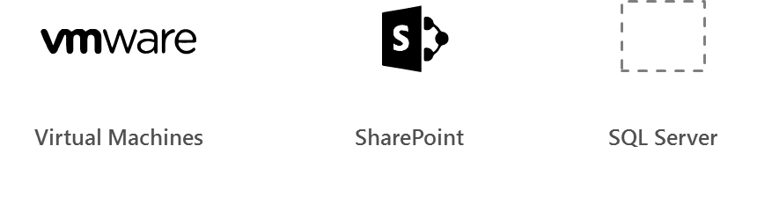
Azure Site Recovery
Azure
Automated, seamless disaster recovery from the cloud to protect applications
Provides application-consistent recovery of critical workloads
Leverage current investments
Orchestrate one-click recovery even for complex multi-tier applications
WHEN NOT
Workload requires synchronous replication, data outside of VHD
Exchange
SAP
Production Environment
SharePoint
App n
Automated
Policy-based
Orchestrated
Encrypted
VPN
ExpressRoute
Downtime
Exchange
SAP
SharePoint
App n
Production Environment
Hyper-V
Bare metal
On-premises/cloud Datacenter

Slide 53
Azure Site Recovery
Replication support:
On-premises VMware VMs
Hyper-V VMs
Windows and Linux physical servers
Disks <= 1023 GB
VMs with 64 disks (64 TB) and leverage SQL Always On for DB workload
Gen-2 to Gen-1 Hyper-V conversion at failover
Push install from ASR – remote WMI and file and printer sharing
Notes:
Now let’s make sure we are using the same terminology for the various parts of a business continuity strategy.
HA is
DR is
Backup is
I’m going to focus on Backup and DR.

Slide 54
Azure Site Recovery support matrix *
Source | Target | Availability | Supported Guest OS Types
Hyper-V 2012 R2 | Azure | Available | All Guest OS types supported by Azure
Hyper-V 2008 R2 SP1 and 2012 | Azure | Available | Windows* and Linux*
VMware vSphere 5.1, 5.5, 6.0 and Physical Servers | Azure | Available | Windows* and Linux*
Amazon Web Services (Windows AMIs) | Azure | Available | Windows Server 2008 R2 SP1+ (HVM only)
Amazon Web Services (Linux AMIs) | Azure | Available | RHEL 6.7 HVM
Hyper-V 2012 | Hyper-V 2012R2 | Available | All Guest OS types supported by Hyper-V
VMware vSphere 5.1, 5.5, 6.0 | Hyper-V 2012R2 | Available via Microsoft Services Global Delivery | Windows Server 2008 R2 SP1+
* May be asked on the exam what ASR will support for a certain scenario
Source: https://docs.microsoft.com/en-us/azure/site-recovery/
Notes:
Notes:
*Limited to Windows Server 2008 R2 SP1+, Red Hat 6.7, 7.1, 7.2, CentOS 6.5, 6.6, 6.7, 7.0+ Oracle Enterprise Linux 6.4, 6.5, SUSE Linux Enterprise Server 11 SP3
*Documentation: https://docs.microsoft.com/en-us/azure/site-recovery/
Azure VM between Azure Region is in Preview now

Slide 55
Azure Site Recovery OS support
Supported operating systems for Azure VMs Supported operating systems for VMware VMs
Supported operating systems for physical servers
For Hyper-V VMs, any guest OS supported by Azure and Hyper-V is supported.

Slide 56
Azure BC/DR Capabilities & Use Cases
Hyper-V Replica
Simple, Affordable Second Site
“Extended Replication” + 3rd Party Integration
Hardware Agnostic – either side
Hybrid Cloud
Seamless Integration:
Private Cloud or on-premises to…
Service Provider Cloud
Microsoft Azure
Azure Site Recovery (ASR)
WHEN TO USE: 2nd Site / Use SCCM,SCVMM, Unprotected workloads
WHEN NOT TO USE:
Workload requires synchronous replication, data outside of VHD
Workload needs to recover physical servers, beyond Hyper-V replica’s capabilities

Slide 57
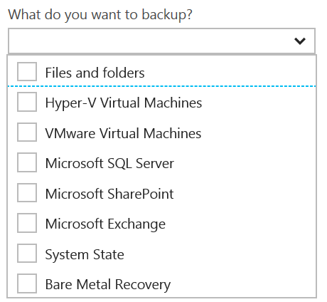
Disaster Recovery Capabilities & Use Cases
Azure Backup
Reliable, Simple, Efficient backup and restore (agent based)
Use for Branch Office or Small Business
Backup and restore files and folders
No Central Management
Azure Backup Server
Disk (D2D), giving high RTOs for tier 1 workloads
Azure (D2D2C) for long term retention
Modern Backup Storage technology (MABS v2)
VMware capabilities
Application Consistency (SQL, Exchange, SharePoint)
No Tape Backup
No Integration with System Center
Requires Azure Subscription
System Center Data Protection Manager (DPM)
Physical, VM, Azure VM
Store Locally to Disks (D2D) and to Tape (D2T)
Store in Azure (D2D2C) for long term retention
Full application consistency across server apps (Exch, SP, SQL…)
Small backup window
Bare Metal Recovery / Recovery to Azure
Full System Center Integration (discovery, reporting, etc)
StorSimple
Proprietary Device | Multiple Tiers
Cloud Integrated Storage (CiS)
Seamless view of ALL Enterprise Storage
Windows and VMWare
Multi-Tiers backup and recovery (Hot/Cold)
Fastest Solution
Long Term Azure storage; scale storage out to Azure
minimize on-premesis disk requirements
Seamless view of ALL Enterprise Storage | Windows and VMWare

Slide 58
Additional Information: SLA for Site Recovery 99.9%
"Failover" is the process of transferring control, either simulated or actual, of a Protected Instance from a primary site to a secondary site.
"On-Premises-to-Azure Failover" is the Failover of a Protected Instance from a non-Azure primary site to an Azure secondary site. Customer may designate a particular Azure datacenter as a secondary site, provided that if Failover to the designated datacenter is not possible, Microsoft may replicate to a different datacenter in the same region.
"On-Premises-to-On-Premises Failover" is the Failover of a Protected Instance from a non-Azure primary site to a non-Azure secondary site.
"Protected Instance" refers to a virtual or physical machine configured for replication by the Site Recovery Service from a primary site to a secondary site. Protected Instances are enumerated in the Protected Items tab in the Recovery Services section of the Management Portal.

Slide 59
Sharding is when you split a database and partition the different parts of the database across multiple drives. A shard is a single horizontal partition of the database.
Notes:
Large table
Just SQL Database table into small
A to D in one database
E to G in another DB
They should be pulled together
You can setup the large database per day basis or per week depending on it.
Existing application can’t be move to sharding. You will have re write the code into the application. Use different API. It is ane xtra work. For scaling point is it amazing. It is only for Relational Database. RDBMS

Slide 60
AzureRM.RecoveryServices.Backup (PowerShell)
Backup Azure VMs using Automation
Concepts
Setup and Registration
Create a recovery services vault
View the vaults in a subscription
Back up Azure VMs
Trigger a backup
Monitoring a backup job
Restore an Azure VM
Create a VM from restored disks
Next steps
https://docs.microsoft.com/en-us/azure/backup/backup-azure-vms-automation

Slide 61
Data Protection Manager & Azure Backup
DPM will backup more workloads
SQL, Exchange, SharePoint
DPM is deployed on-premises as a physical server or virtual machine—If you deploy DPM as a physical server or as an on-premises Hyper-V virtual machine you can back up data with Azure Backup in addition to backing data up to disk and tape.
Azure Backup provides a simple method of offsite storage. You can store data with Azure up to 3360 days
DPM is deployed as a virtual machine in Azure—If DPM is deployed as an Azure virtual machine (possible from System Center 2012 R2 with Update 3 or later) you can back up data to Azure disks attached to the DPM Azure virtual machine and then offload data storage with backup to Azure Backup.
You can offload storage to Azure Backup from the Azure disk, allowing you to scale up by storing older data in Azure Backup and new data on disk
https://technet.microsoft.com/en-us/library/jj728752(v=sc.12).aspx

Slide 62
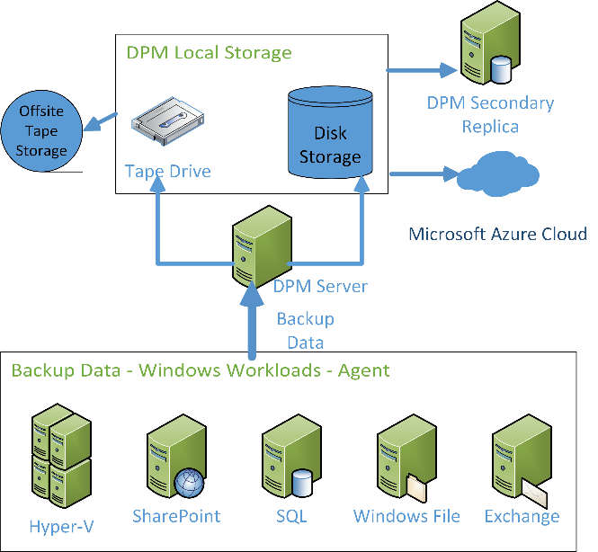
DPM Architecture
Data Protection Manager backing up Microsoft workloads and sending that data through the Data Protection Manager server to local storage and tape, the tape is being sent offsite. Data is also being sent to a Data Protection Manager Secondary Replica and to Microsoft Azure.

Slide 63
READ & Practice https://docs.microsoft.com/pdfstore/en-us/Azure.azure-documents/live/backup.pdf
Link from https://docs.microsoft.com/en-us/azure/backup/backup-try-azure-backup-in-10-mins – Download PDF

Slide 64
Azure Backup Key Workloads
Specialized Workloads
File/Folders/Volumes
Virtual Machines
Exchange
SharePoint
SQL Server
Windows Server
Windows
Windows
Linux
Hyper-V
Windows Server
Microsoft Azure
VMware
Notes:
1.
Workload: Files and folders
Source Machine: Windows Server or Windows Client
Azure Backup Solutions:
Azure Backup agent,
System Center DPM (+ the Azure Backup agent),
Azure Backup Server (includes the Azure Backup agent)
2.
Workload: Hyper-V virtual machine (Win & Linux), VMWare Virtual Machine (Win & Linux), Microsoft SQL Server, Microsoft SharePoint, Microsoft Exchange
Source Machine: Windows Server
Azure Backup Solution: System Center DPM (+ the Azure Backup agent); Azure Backup Server (includes the Azure Backup agent)
3.
Workload: Azure IaaS VMs (Windows) and Azure IaaS VMs (Linux)
Source Machine: N/A
Azure Backup Solution: Azure Backup (VM extension)

Slide 65
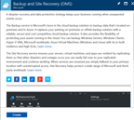
How It Works: Azure Backup Server
2. Register and configure Vault
1. Create Backup and Site Recovery Vault
3. Install Azure Backup Server software
4. Schedule & Back up encrypted data
Azure Backup Windows Server/Client
5. Recover to the same or a different server; On-Premisis or Azure VM
Step-By-Step
https://docs.microsoft.com/en-us/azure/backup/backup-try-azure-backup-in-10-mins
Notes:
Sign Up at the Azure portal
Install Azure Backup Server software
Register and configure
Back up encrypted data
Anytime the data leaves your boundary, it is encrypted. You have the passwords and keys and it’s always restored in Azure.
Recover to the same or a different server

Slide 66
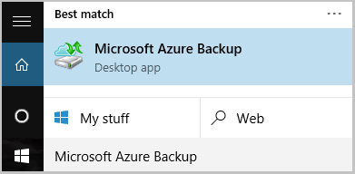
Name of the Backup agent Installer is:
MARSagentinstaller.exe
Backup Agent is
Microsoft Azure Backup
"C:\Program Files\Microsoft Azure Recovery Services Agent\bin\wabadmin.msc"
Maximum rate of backups per day?
Three (3) times per day!
Notes:
Maximum backup is 3 times per day – every 8 hours

Slide 67
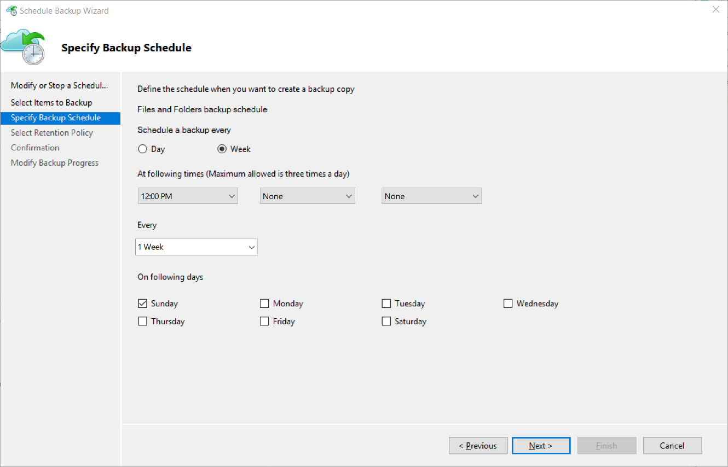
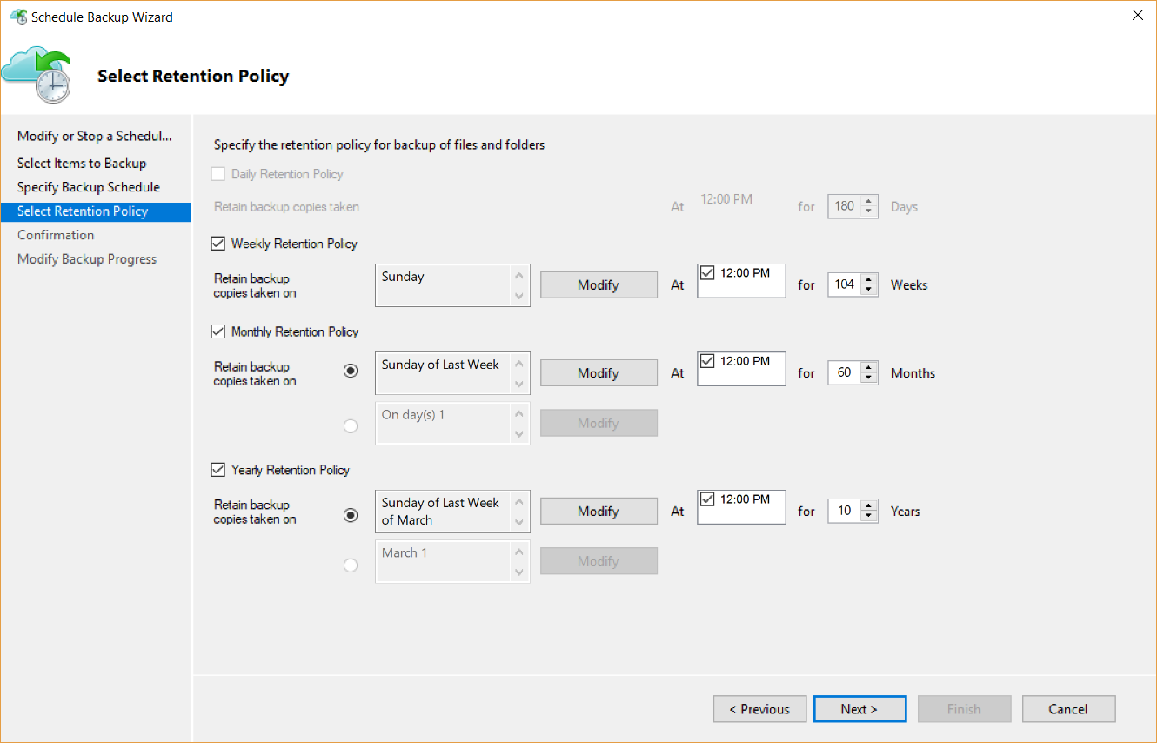
Backup Schedule & Retention Policy
Backup Schedule
Retention Policy

Slide 68
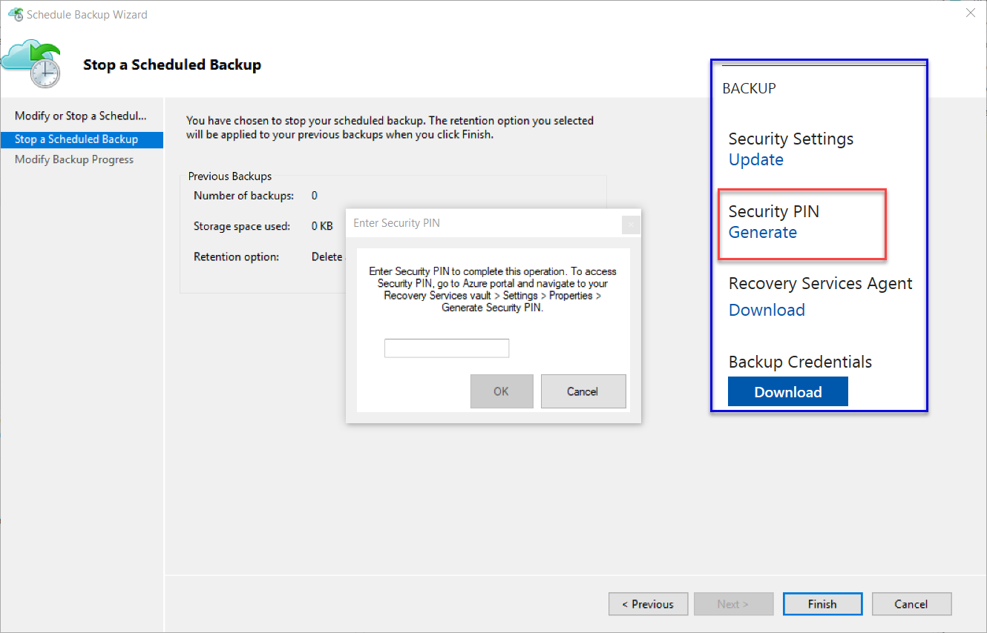
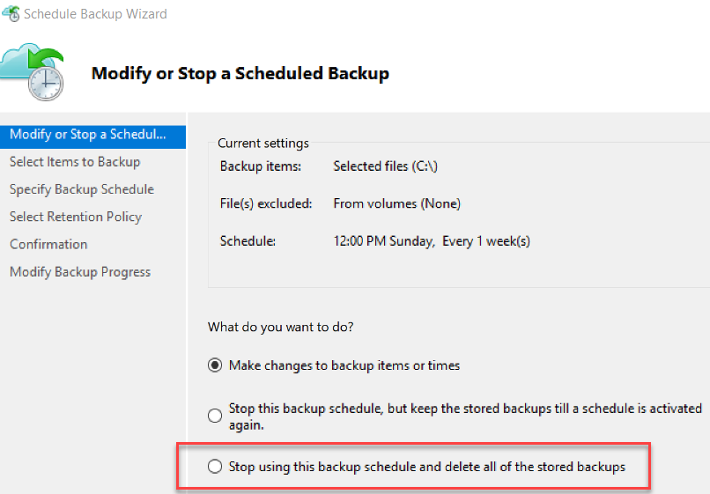
Cancelling Schedule and Removing Backups

Slide 69
Microsoft Azure Backup Server v2
Protect application workloads:
Hyper-V VMs, Microsoft SQL Server, SharePoint Server, Microsoft Exchange and Windows clients
Backup To:
Disk (D2D), giving high RTOs for tier 1 workloads
Azure (D2D2C) for long term retention
Modern Backup Storage technology (MABS v2) store backups:
Using Resilient File System (ReFS) block-cloning technology to store incremental backups,
MABS v2 significantly improves storage usage and performance.
Note: VMware is supported only in testing if Azure Backup Server is deployed on Windows 2016
Microsoft Azure Backup Server (MABS) Deployment:
physical standalone server.
Hyper-V virtual machine
Windows virtual machine in VMWare
Physical standalone server
Hyper-V virtual machine
Windows virtual machine in VMWare
An Azure virtual machine - back up cloud workloads running as Azure virtual machines.
Disks for backup storage pool: 1.5 times size of data to be protected
Docs: https://azure.microsoft.com/en-us/blog/announcing-microsoft-azure-backup-server/
Download: https://www.microsoft.com/en-us/download/details.aspx?id=55269

Slide 70
Documentation / More Info…
Azure Key Vault:
https://docs.microsoft.com/en-us/azure/key-vault/
Azure Backup:
https://docs.microsoft.com/en-us/azure/backup/

Slide 71
When you create a recovery vault for Backup, use a different region than that of the servers and services you will be backing up. This will provide a level of protection against a regional disaster such as the failure of an Azure datacenter or hurricane that can take out an entire region including your on-premises datacenter.
Backup imposes a limit of 1,700 GB of data per volume that that you can back up in one backup operation
Limit of 366 Restore Points
Almost 10 years of retention (3,360 days / 9.2 years)

Slide 72
More Tools + 3rd Party Tools --- Many
Most Backup Solutions will now backup to Azure; Including:
3rd Party
Microsoft
Veeam Backup – Restore Directly to Azure; Many workloads including SharePoint, AD, Exchange, Files, SQL…
NetBackup
Veritas
Acronis
CommVault
More…
Microsoft® SQL Server® Backup to Microsoft Azure®Tool https://www.microsoft.com/en-us/download/details.aspx?id=40740
AZCopy https://docs.microsoft.com/en-us/azure/storage/storage-use-azcopy

Slide 73
Lab: Azure Backup in 10 Mins
Create a recovery services vault
Configure the vault
Install and register the agent
Back up your files and folders
Questions?
Next steps
https://docs.microsoft.com/en-us/azure/backup/backup-try-azure-backup-in-10-mins

Slide 74
6.3 Disaster Recovery Strategy
What Architects Need to Know

Slide 75
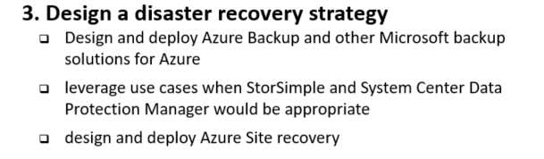
6 Manage, Monitory, Business Continuity

Slide 76
6.4 Design a disaster recovery strategy
Design and deploy Azure Backup and other Microsoft backup solutions
Use cases for StorSimple and System Center Data Protection Manager
Design and deploy Azure Site Recovery

Slide 77
Disaster recovery strategy
Backup Solutions
Microsoft Azure Backup
Reliable, Simple, Efficient
Use for Branch Office or Small Business
Hyper-V Recovery Manager
StorSimple
Proprietary Device | Multiple Tiers
Cloud Integrated Storage (CiS)
Seamless view of ALL Enterprise Storage | Windows and VMWare
System Center Data Protection Manager
Can Store backed up DPM data in Azure…
As Physical or VM
As Azure VM

Slide 78
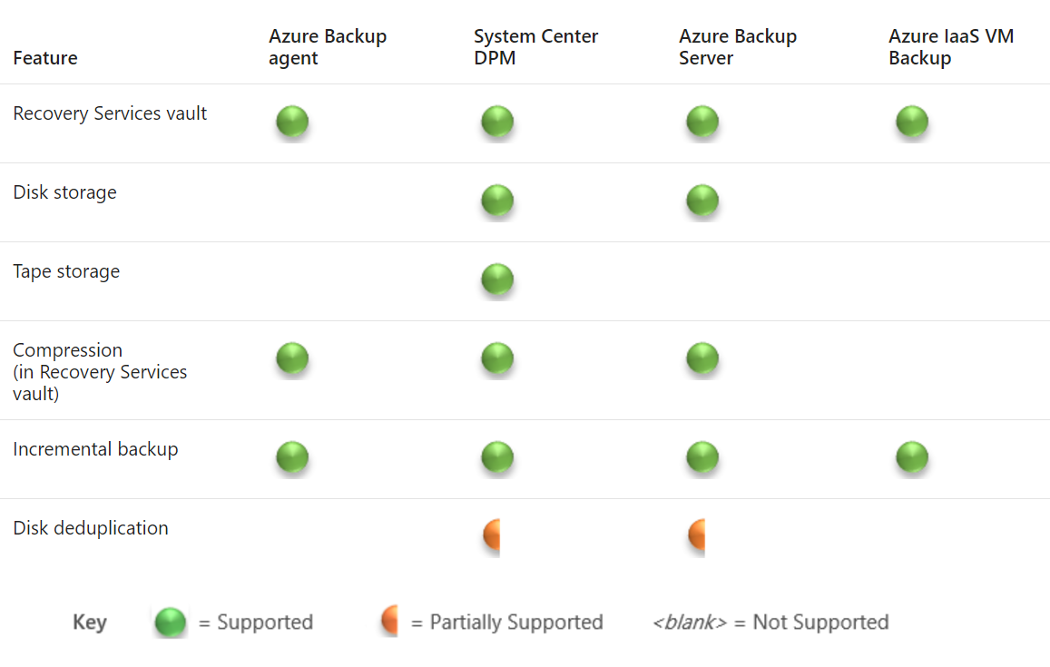
Disaster recovery strategy

Slide 79
Azure Backup
Azure
Create virtual machines with fabric-level protection
Direct-to-cloud backup of files and folders
Built-in protection against ransomware
Economical cloud pricing with pay-as-you- go storage
Large scale, fast backups
Central storage of remote office backups without in-house management
Windows
VMs
App n
Scalable
Reliable
Encrypted
Secure
Production Environment
Windows
VMs
App n
On-premises Datacenter/branch Office

Slide 80
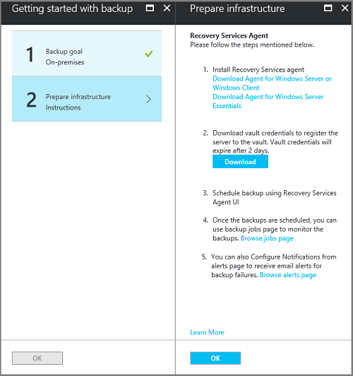
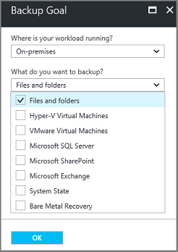
Deploy Azure Backup
Create a Recover Services Vault
Set storage redundancy for the vault (local or geo redundant)
Configure the vault (where and what is backed up)
Prepare the infrastructure
Install and register agent
Backup files and folders
Schedule job in the agent

Slide 81
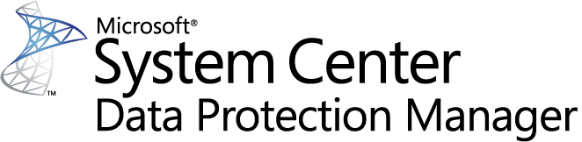




System Center DPM
Application-aware snapshots (VSS)
Full flexibility for when to take backups
Recovery granularity (all)
Can use Recovery Services vault
Linux support on Hyper-V and VMware VMs
Back up and restore VMware VMs using DPM
DPM Agent
VSS Requester
VSS Writer
VSS
VSS Provider
Notes:
Key terms:
Replica
Recovery Point
Initial Replication
Consistency Check
Synchronization
Express Full Backup
A protection group is a collection of data sources that share the same protection configuration. The protection configuration consists of the protection group name and settings for disk allocations, replica creation method, and on-the-wire compression

Slide 82


StorSimple architecture: A new approach
StorSimple Cloud Appliance
Azure
Applications
Microsoft Azure
Periodic VSS consistent cloud snapshots of production data
Internet
Internet
Customer datacenter
Remote/branch offices
Hyper-V
Hyper-V
SAN
Linux
Linux
SAN
NAS
StorSimple Physical Array
VMware
StorSimple Virtual Array
VMware
Notes:
This slide puts it all the solution components together : StorSimple is an easy way to connect any server on any Hypervisor environment – including Hyper-V, Linux, or VMware - to the cloud….with no app modification.
Further, as you can see, we now have the flexibility of configuring StorSimple as a SAN or a NAS device in the customer environment (replacing traditional SAN & NAS devices). i.e.
To a customer, it looks like a SAN or a NAS device – with the added advantage of being able to connect to the cloud. And cloud is what brings all the unique differentiators to the StorSimple solution : including …auto tiering, cloud based data protection, and DR.
This is huge – because now customers are able to combine several heterogeneous pieces of traditional storage solutions (like tape, archival, back-up & restore) into one elegant solution – with a single management console. StorSimple Manager provides a single view & management capabilities for both physical and virtual arrays, as well as StorSimple Cloud Appliance. In addition, StorSimple can be further enhanced for scenarios like enterprise collaboration with our partners like Talon, and video surveillance with MileStone.

Slide 83
How StorSimple works
Enables data mobility between your datacenter and the cloud
StorSimple tiers data
moving aging, less accessed data to the cloud, at lower costs
rather than keeping it with your mission-critical data in your datacenter (or at some remote location).
However, the data in the cloud is still safe and reliably accessible.
This results in:
Lower total storage costs by up to 60%
Improve data protection
Increase storage agility
Enable virtually bottomless storage
Notes:
This slide puts it all the solution components together : StorSimple is an easy way to connect any server on any Hypervisor environment – including Hyper-V, Linux, or VMware - to the cloud….with no app modification.
Further, as you can see, we now have the flexibility of configuring StorSimple as a SAN or a NAS device in the customer environment (replacing traditional SAN & NAS devices). i.e. To a customer, it looks like a SAN or a NAS device – with the added advantage of being able to connect to the cloud. And cloud is what brings all the unique differentiators to the StorSimple solution : including …auto tiering, cloud based data protection, and DR. This is huge – because now customers are able to combine several heterogeneous pieces of traditional storage solutions (like tape, archival, back-up & restore) into one elegant solution – with a single management console. StorSimple Manager provides a single view & management capabilities for both physical and virtual arrays, as well as StorSimple Cloud Appliance. In addition, StorSimple can be further enhanced for scenarios like enterprise collaboration with our partners like Talon, and video surveillance with MileStone.

Slide 84
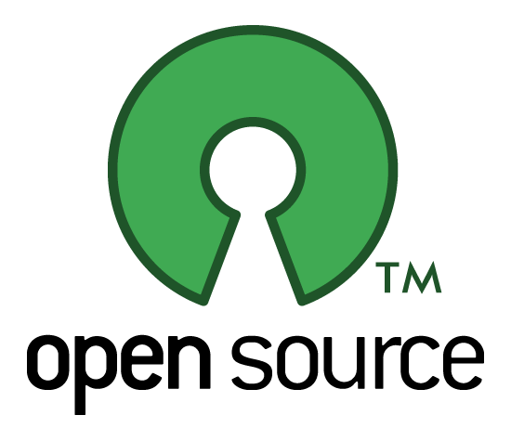
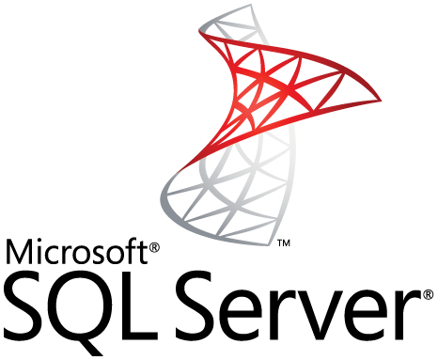

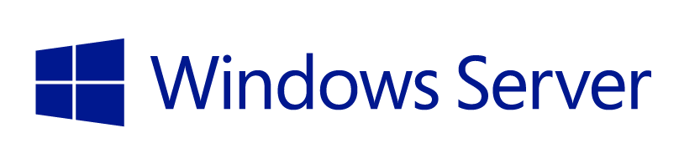
Supported workloads
How customers benefit
Infrastructure on-demand workloads
DR
Search / Data mining
Dev / Test
Cloud apps
Capacity driven workloads
Traditional on-premises workloads
File shares
Collaboration
Archives
VM workloads
SharePoint
SQL Server
Notes:
This slide is shows the alignment of different workloads with different capabilities / configurations of StorSimple solution.
For large, unstructured, capacity driven data-sets, use tiered volumes for cloud storage
For performance driven workloads – use local volumes as a local storage.
For on-demand infra requirements like DR, and dev-test, use the StorSimple Cloud Appliance
So what does all these enhancements mean for partners?

Slide 85
Integrated data protection and DR
How customers benefit
Largescale, on-demand capacity for data protection
Location independence for disaster recovery
Shortened RTO for data availability for apps
No purchases, upgrades and maintenance for backups and tapes
Capability to test and validate DR
DR automation and single-click orchestration
StorSimple Cloud Appliance
Azure
Applications
Microsoft Azure
Periodic VSS consistent cloud snapshots of production data
Data Center 1
Data Center 2
DR
Production data
Production data

Slide 86
Test, validate, and accelerate DR
How customers benefit
Cloud Backup (target for backup software) With 100 Mbps WAN Link
StorSimple ‘instant recovery’
= faster RTO than tapes
and cloud gateway backups
90 Days
30 Days
Tape
7 Days
RTO is independent of volume sizes
>100x faster than tapes and regular cloud backup
Off-site Backups
1 Day
StorSimple Cloud Snapshots with 50 Mbps WAN link
1 Hour
15 Min.
1 TB
5 TB
20 TB
50 TB
100 TB
Primary Data

Slide 87
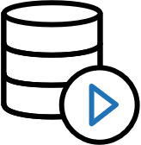
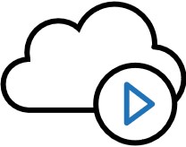
Focus on business outcomes
How customers benefit
On-demand storage
On-demand services in Azure
Consolidated management
Highly scalable, cost-effective and secure data storage. No need for incessant planning, upgrade and maintenance
Cloud provides IaaS to deploy applications that use StorSimple data in the cloud. No long lead times for new business projects
No need to manage separate data protection solutions or be on-site. Up-to-the-minute status and consistent control in all sites

Slide 88
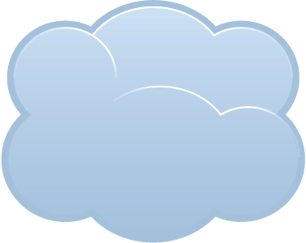
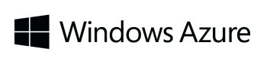

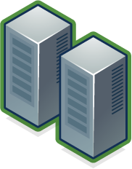
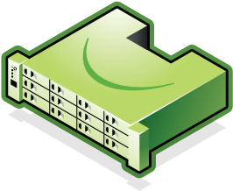
Cloud Snapshots Provide Rapid Recovery
Cloud
Snapshots
Production Data
Production Data
Enterprise Data Center 1
Enterprise Data Center 2
Connect many servers to cloud storage and scale data sets with StorSimple solution
Rapidly recover to any data center (location independent) via mounting the cloud
Notes:
Slide Objective: Discuss rapid recovery capabilities provided by StorSimple in the event of a datacenter outage.

Slide 89
SimpleStore Technology – Hybrid Storage
SSD
SAS
Automated Tiering
Dedup Compression
Thinn Provision
Application snapshot
Certified from VmWare
Only Restore the Data in need – The Working Set
Notes:
Slide Objective: Discuss rapid recovery capabilities provided by StorSimple in the event of a datacenter outage.

Slide 90
EXAM TIP!
StorSimple uses iSCSI protocol to link data storage. This means that the storage that is in Azure is presented as locally attached iSCSI volumes.

Slide 91
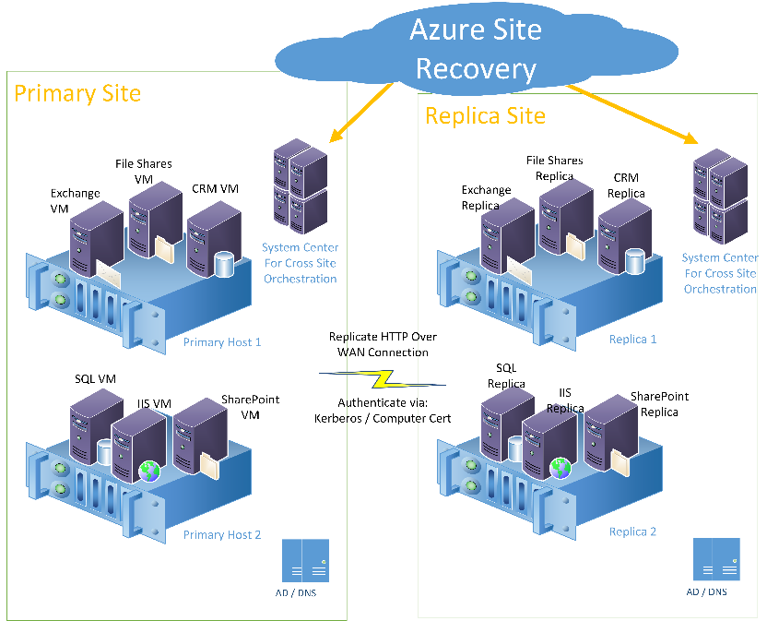
6.3.3 Site Recovery primary site and replica site
Azure Site Recovery monitoring a primary and replica site. The sites have workloads such as Exchange, CRM, IIS, SQL, and SharePoint running on hosts. Azure Site Recovery communication goes through System Center. System Center actually performs the orchestration of the cutover

Slide 92
Replicate Hyper-V virtual machines (without VMM) to Azure using Azure Site Recovery with the Azure portal
https://docs.microsoft.com/en-us/azure/site-recovery/site-recovery-hyper-v-site-to-azure

Slide 93
Replicate physical machines to Azure by using Site Recovery
https://docs.microsoft.com/en-us/azure/site-recovery/site-recovery-physical-servers-to-azure

Slide 94
6.4 Design Azure Automation

Slide 95
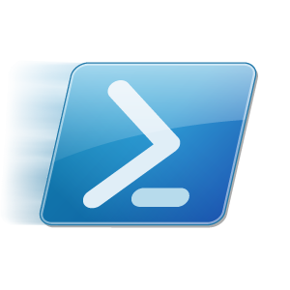
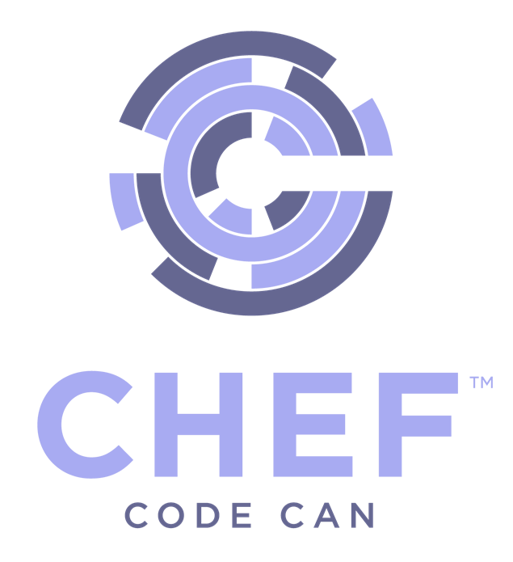
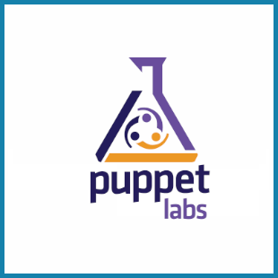
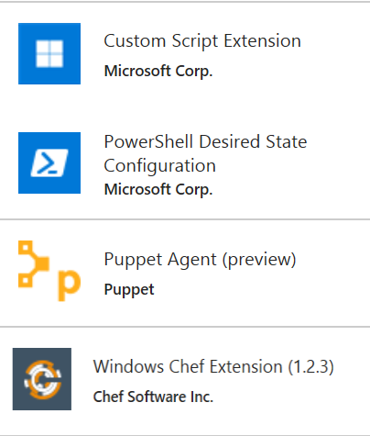
Azure Automation
Azure Automation
Runbooks
Chef Configure and Automate. Apply Fine Grained Permissions
https://www.chef.io/solutions/windows/
Puppet Can Configure and Manage Windows and Azure
http://puppetlabs.com/solutions/microsoft
Desired State Configuration
Make it So https://docs.microsoft.com/en-us/azure/automation/automation-dsc-overview
In the portal + New – Azure Automation
DevOps Enabler
Others, Docker, Ansible, SaltStack, etc.

Slide 96
Which to use? All can be used with Windows & Linux
Chef
If you already have a Chef management infrastructure
If your primary expertise is managing Linux machines
Puppet
If you already have a Puppet management infrastructure
If your primary expertise is managing Linux machines
DSC
If you do not already have a Configuration Management Solution
If your primary experience is in managing Windows machines
Uses vender-neutral configuration files (MOF)
If you already have PowerShell expertise
Azure Automation
If you do not already have a Configuration Management Solution, or not deeply embedded
If you want to significantly expand your configuration management without significant expense
If you already own OMS
If you already have PowerShell expertise

Slide 97
Chef & Puppet
Chef
Cross-OS systems management, automation, and analytics output
Ruby and Git are required + agent is on target machine
Good for development focused teams (code driven approach to configuration)
Leverage Chef in Azure when already using it.
Puppet
Stable and mature so good for managing large, heterogeneous enterprise environments
Automate systems configuration & enforce consistency
Large Open Source catalog of modules and runs on nearly every OS (cross platform)

Slide 98
6.5 Describe the use cases for Azure Automation configuration
Evaluate when to use Azure Automation, Chef, Puppet, PowerShell, or Desired State Configuration (DSC)

Slide 99
Azure Automation
PowerShell & PS Workflow Engines
Use your existing PS scripts
Checkpoint/Parallel if needed
Runbooks, Modules
Author PS, PSWF, Graphical runbooks
Gallery – Runbooks, modules
Extensibility, integration
Assets
Secure, global store for variables, credentials, …
Schedules
Jobs
Troubleshoot/audit via job history
PowerShell DSC
Configurations, Pull service
Node Management & Reporting
Hybrid Runbook Workers
Install on any machine
Secure, only outbound ports
Webhooks
URL to start runbook remotely
Integration
Azure Automation
Orchestrator
Hybrid Worker
SCO
SMA
Hyper-V
VMWare
OpenStack

Slide 100
PowerShell for automation
Automating repeatable, identical tasks
Creating resources such as VMs
Tasks that are very time consuming or prone to error

Slide 101
Desired State Configuration (DSC)
Install or remove windows roles and features
Running Windows PowerShell scripts
Managing registry settings
Managing files and directories
Starting, stopping, and managing processes and services
Managing groups and user accounts
Deploying new software
Managing environment variables
Discovering the actual confi guration state on a given node
Fixing a confi guration that has drifted away from the desired state

Slide 102
Create a standalone Azure Automation account
Create a new Automation Account from the Azure portal
https://docs.microsoft.com/en-us/azure/automation/automation-create-standalone-account

Slide 103
Azure Automation Use Cases
Monitoring Configurations
Eliminate Configuration Drift
Automated Change of Configuration
Maintain Exact Configuration (override other changes)
Automated Testing
Automating Usage – Auto Start – Auto Stop
Automating Hybrid Scenarios
Automated Deployment
Implement DevOps practices
Notes:
Azure Automation is SaaS application
It automate processes with runbooks and manage configuration changes to Windows and Linux systems using Desired State Configuration (DSC) in Azure
Support other cloud services, or on-premises.
Runbooks that you run in Azure are executed on Automation sandboxes
To automate the deployment and management of resources in your local datacenter or other cloud services, after creating an Automation account, you can designate one or more machines to run the Hybrid Runbook Worker (HRW) role.
Each HRW requires the Microsoft Management Agent with a connection to a Log Analytics workspace and an Automation account.
Log Analytics is used to bootstrap the installation, maintain the Microsoft Management Agent, and monitor the functionality of the HRW.
The delivery of runbooks and the instruction to run them are performed by Azure Automation.
You can deploy multiple HRW to provide high availability for your runbooks, load balance runbook jobs,
and in some cases dedicate them for particular workloads or environments.

Slide 104
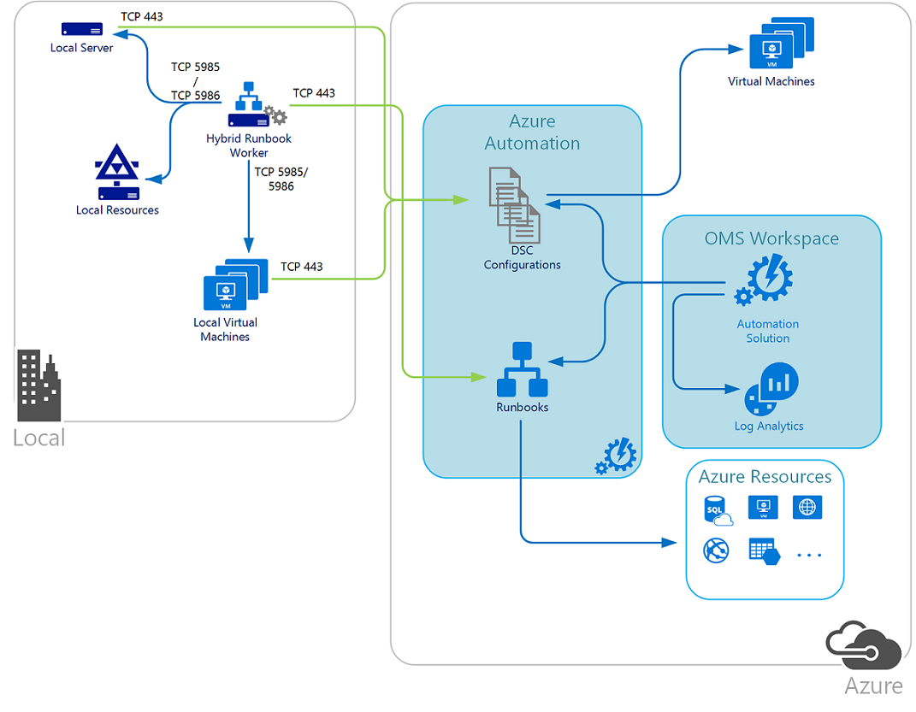
Hybrid Azure Automation - DSC
DSC configurations stored in Azure Automation can be directly applied to Azure virtual machines. Other physical and virtual machines can request configurations from the Azure Automation DSC pull server.
Note
TCP 443 from local to Azure
TCP 5985/5986 Hybrid Runbook Worker to local machines and resources
Hybrid Runbook worker is running locally and managing local resources
https://docs.microsoft.com/en-us/azure/automation/automation-offering-get-started

Slide 105
Thank You

